Slide 1
Object Oriented Programming—C++ Lecture7 Template Classes + Const Correctness
Qijun Zhao
College of Computer Science
Sichuan University
Spring 2023

Slide 2
This lecture combines reading materials: Pages 233-292 of the textbook.
(Chapter 9: Refining Abstractions)

Slide 3
Today
- Classes Recap
- Template Classes
- Const Correctness

Slide 4
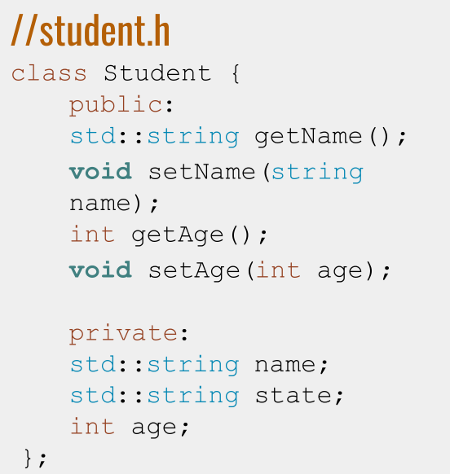
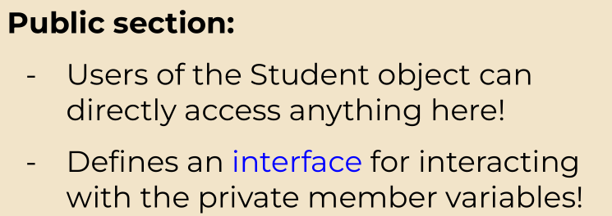
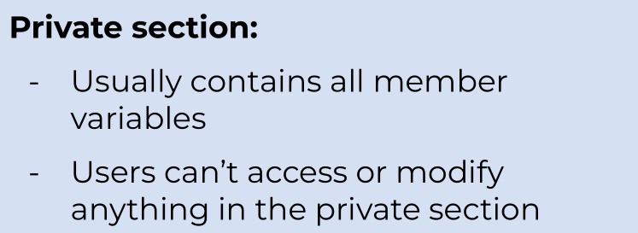
Turning Student into a class: Header File

Slide 5
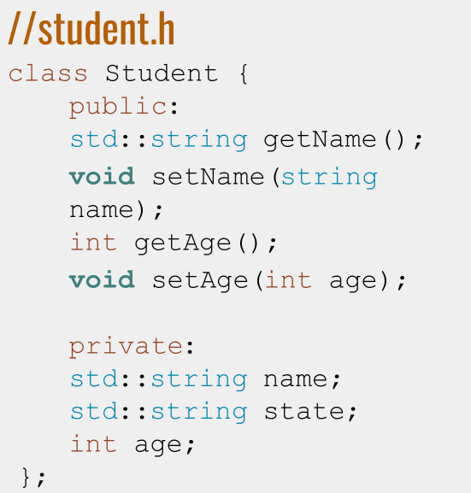
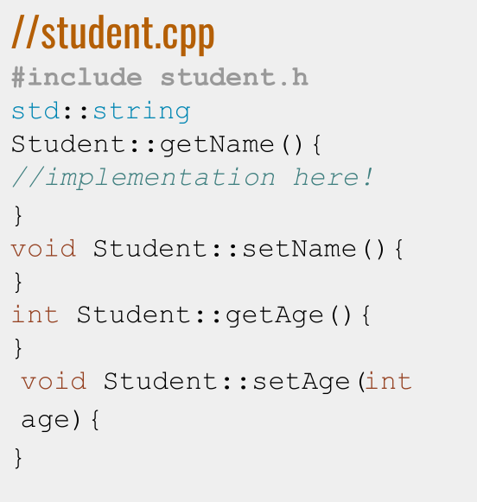
Turning Student into a class: Header File + .cpp File

Slide 6
The problem with StrVector
- Vectors should be able to contain any data type!
- What if we want to make a vector of Students?
- How are we supposed to know about every custom class?
- What if we don’t want to write a class for every type we can think of?

Slide 7
Definition
Template Class: A class that is parametrized over some number of types. A class that is comprised of member variables of a general type/types.

Slide 8
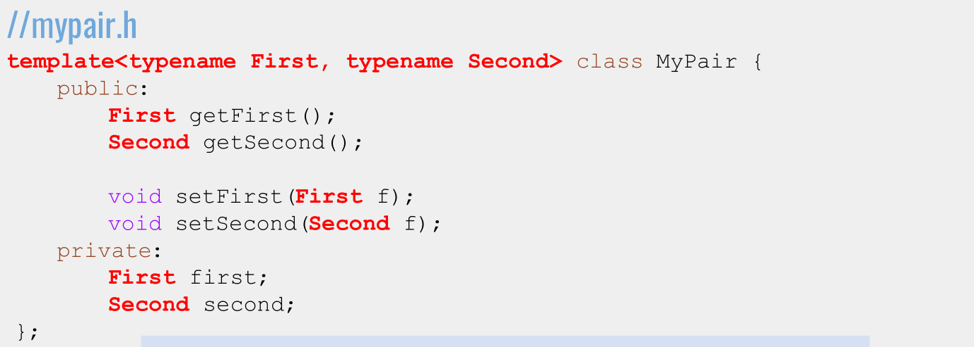

Writing a Template Class: Syntax

Slide 9
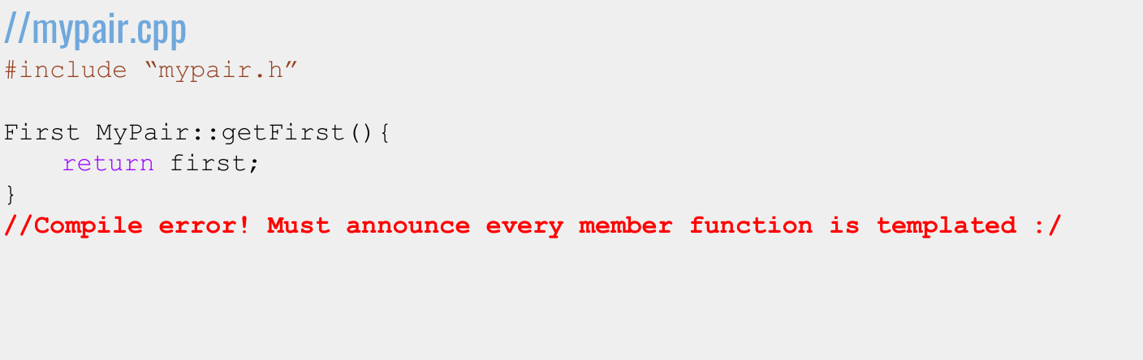
Implementing a Template Class: Syntax

Slide 10
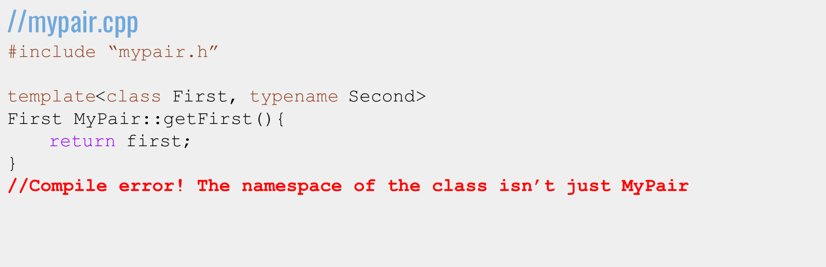
Implementing a Template Class: Syntax

Slide 11
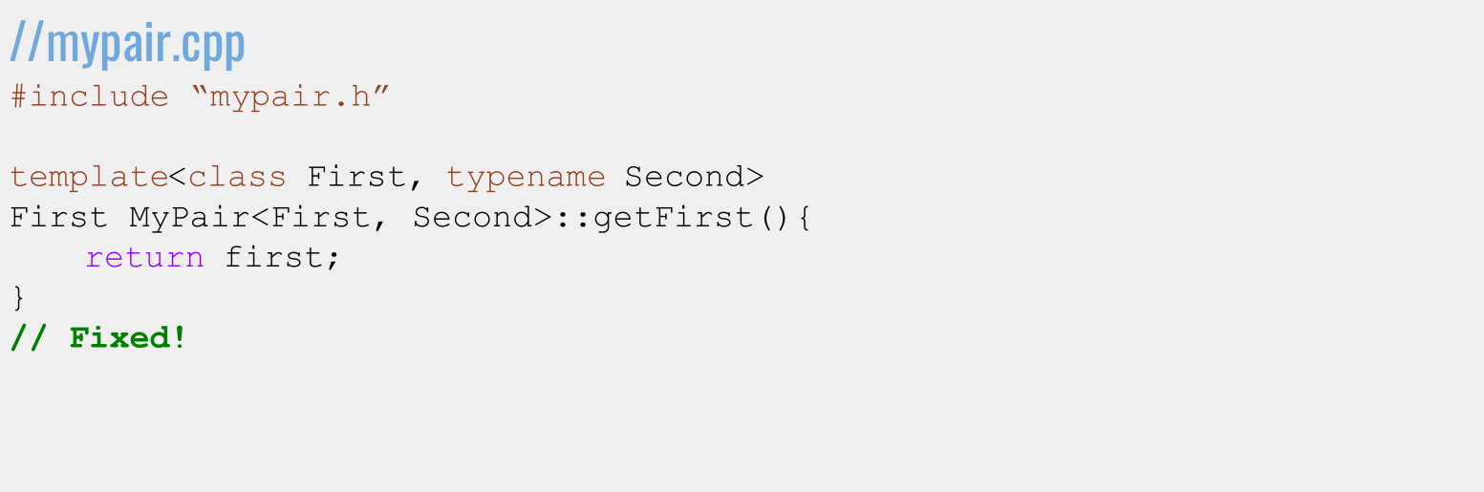
Implementing a Template Class: Syntax

Slide 12
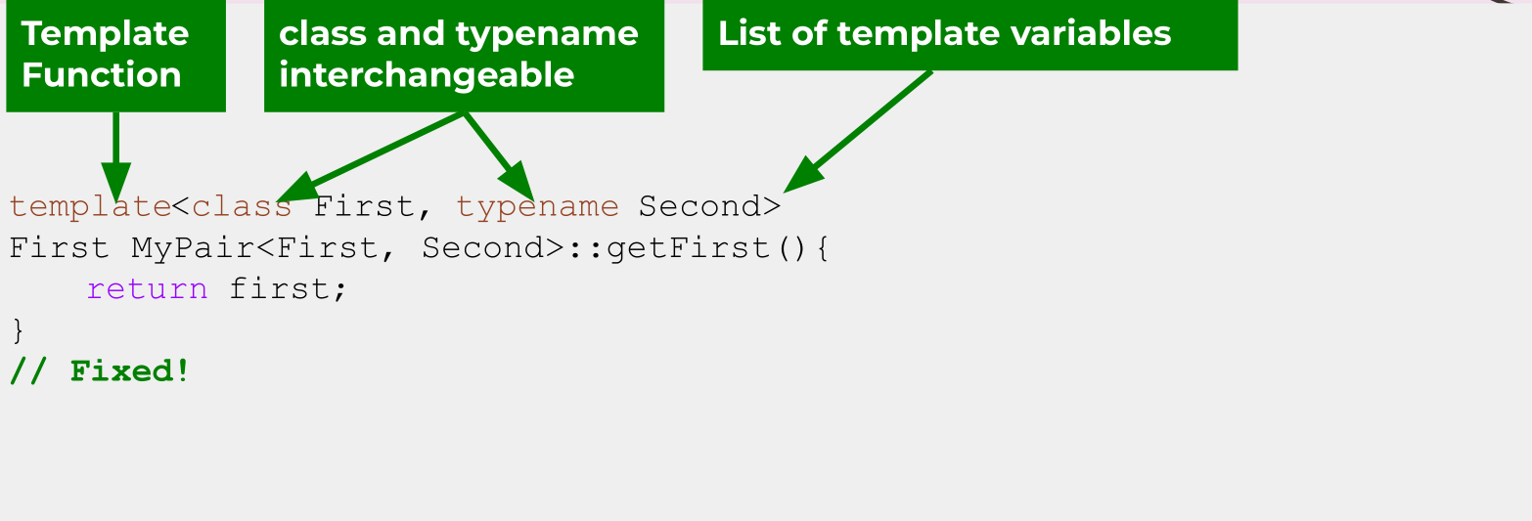
Implementing a Template Class: Syntax

Slide 13
Today
- Classes Recap
- Template Classes
- Const Correctness

Slide 14
Member Types
- Sometimes, we need a name for a type that is
dependent on our template types
- Recall: iterators
- iterator is a member type of vector

Slide 15
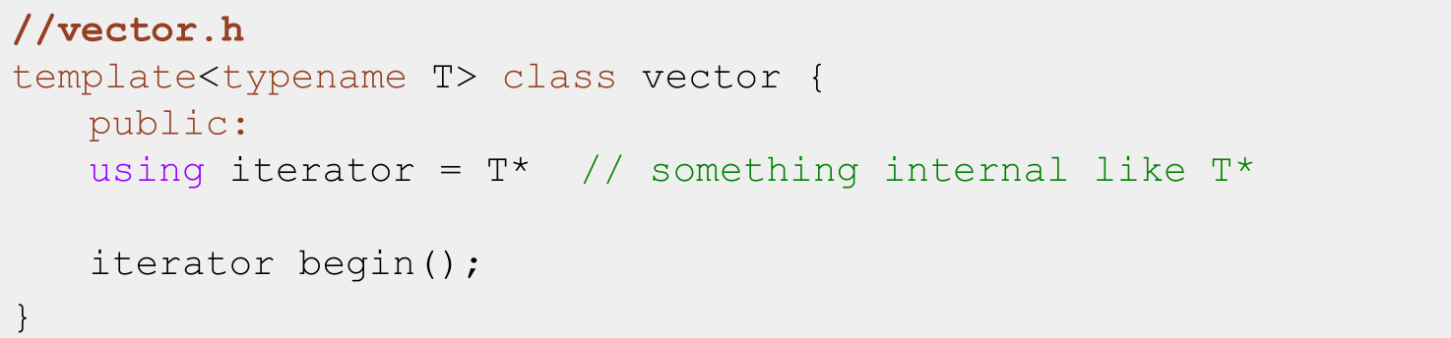
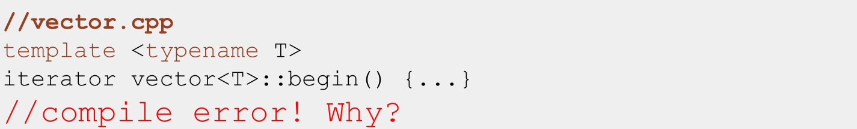
Member Types: Syntax

Slide 16
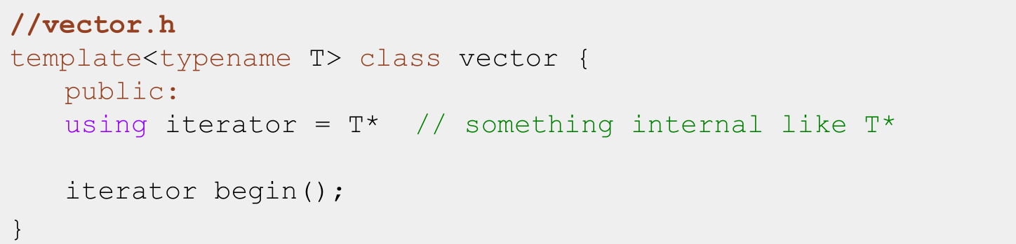
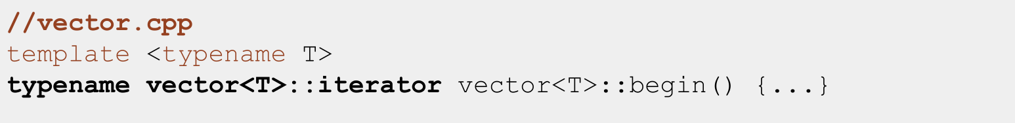
Member Types: Syntax

Slide 17
Aside: Type Aliases
- You can use using type_name = type in application code as well!
- When using it in a class interface, it defines a nested type, like vector::iterator
- When using it in application code, like main.cpp, it just creates another name for type within that scope (until the next unmatched })

Slide 18
Member Types: Summary
- Used to make sure your clients have a standardized way to access important types.
- Lives in your namespace: vector<T>::iterator.
- After class specifier, you can use the alias directly(e.g. inside function arguments, inside function body).
- Before class specifier, use typename.

Slide 19
An unintuitive (at first!) bug
The Takeaway
Templates don’t emit code until instantiated, so include the .cpp in the .h instead of the other way around!

Slide 20
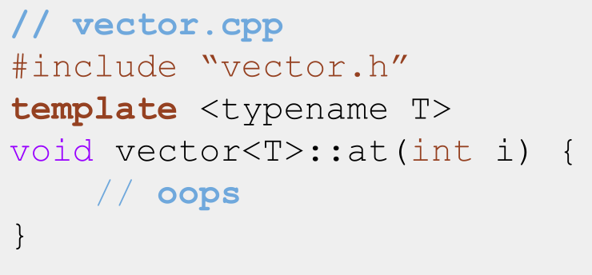
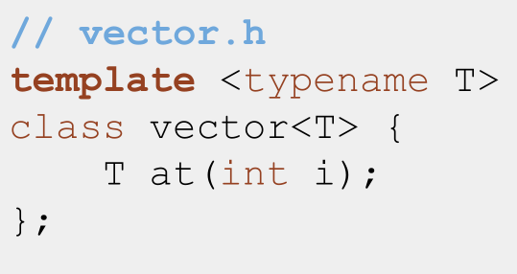
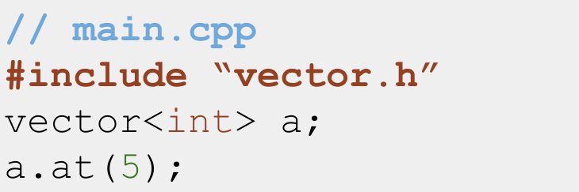
A compile error....

Slide 21
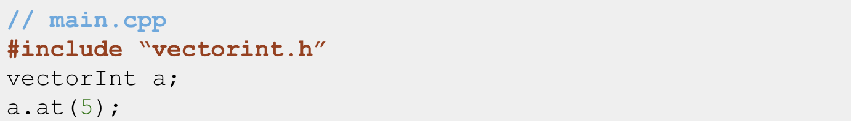
What the C++ compiler does with non-template classes
1. g++ -c vectorint.cpp main.cpp: Compile and create all the code in vectorint.cpp and main.cpp. All the functions in vectorint.h have implementations that have been compiled now, and main can access them because it included vectorint.h
2. “Oh look she used vectorInt::at, sure glad I compiled all that code and can access vectorInt::at right now!”

Slide 22
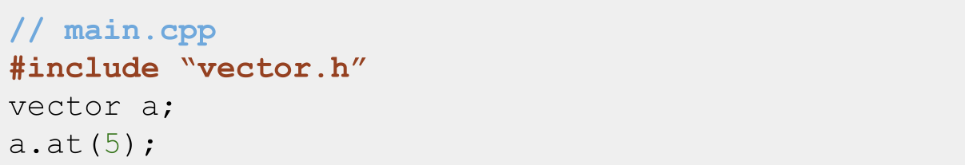
What the C++ compiler does with template classes
1. g++ -c vector.cpp main.cpp: Compile and create all the code in main.cpp. Compile vector.cpp, but since it’s a template, don’t create any code yet.
2. “Oh look she made a vector<int>! Better go generate all the code for one of those!”
3. “Oh no! All I have access to is vector.h! There’s no implementation for the interface in that file! And I can’t go looking for vector<int>.cpp!”

Slide 23
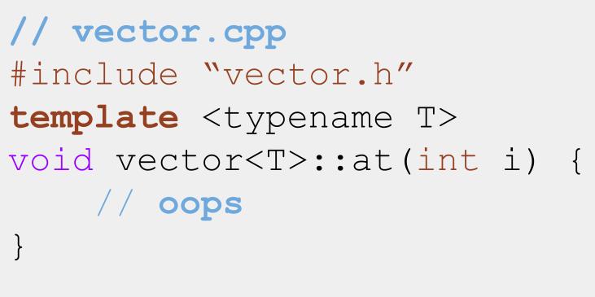
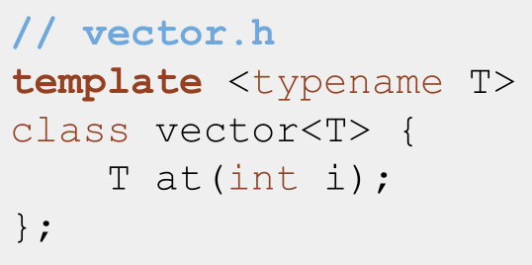
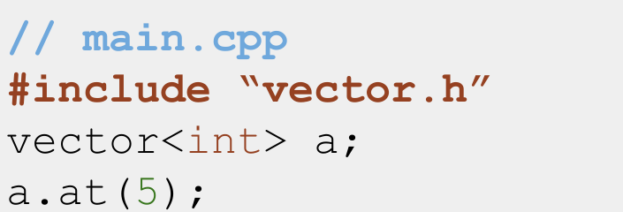
The fix...

Slide 24
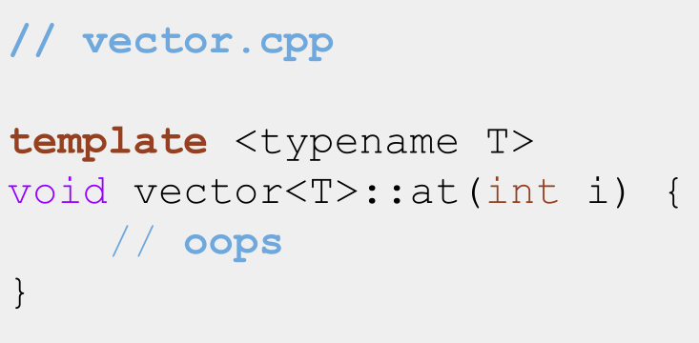
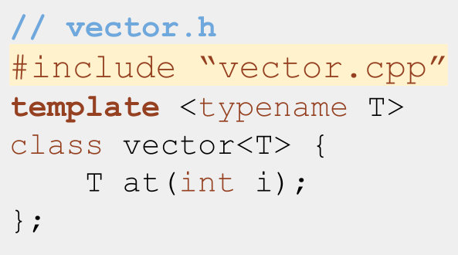
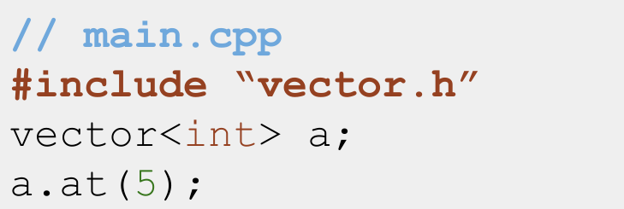
Include vector.cpp in vector.h!

Slide 25
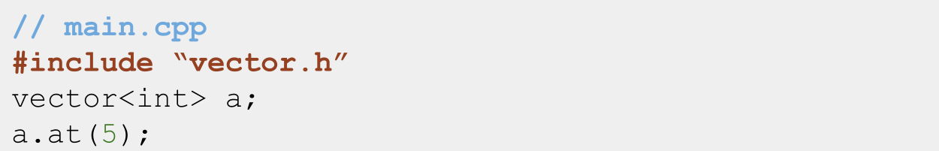
What the C++ compiler does with template classes
1. “Oh look she included vector.h! That’s a template, I’ll wait to link the implementation until she instantiates a specific kind of vector”
2. “Oh look she made a vector<int>! Better go generate all the code for one of those!”
3. “vector.h includes all the code in vector.cpp, which tells me how to
create a vector<int>::at function :)”

Slide 26
The Takeaway
Templates don’t emit code until instantiated, so include the .cpp in the .h instead of the other way around!

Slide 27
Recap: Template classes
- Add template<class T1, T2..> before class definition in .h
- Add template<class T1, T2..>before all function signatures in .cpp
- When returning nested types (like iterator types), put typename ClassName<T1, T2..>::member_type as return type, not just member_type
- Templates don’t emit code until instantiated, so #include the .cpp file in the .h file, not the other way around!

Slide 28
Today
- Classes Recap
- Template Classes
- Const Correctness

Slide 29
Definition
const: keyword indicating a variable, function or parameter can’t be modified

Slide 30
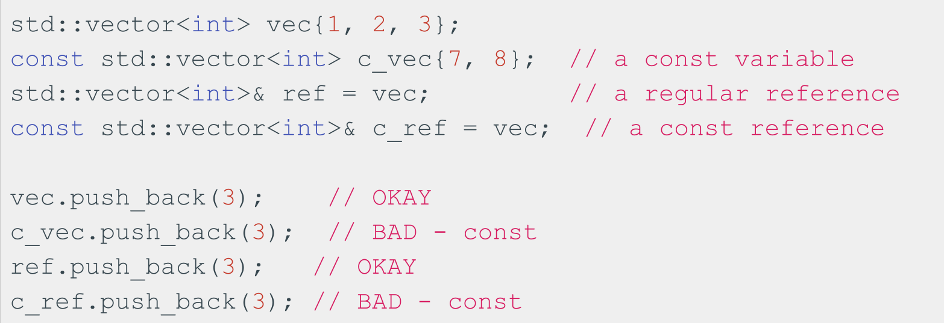
const indicates a variable can’t be modified!
const variables can be references or not!

Slide 31
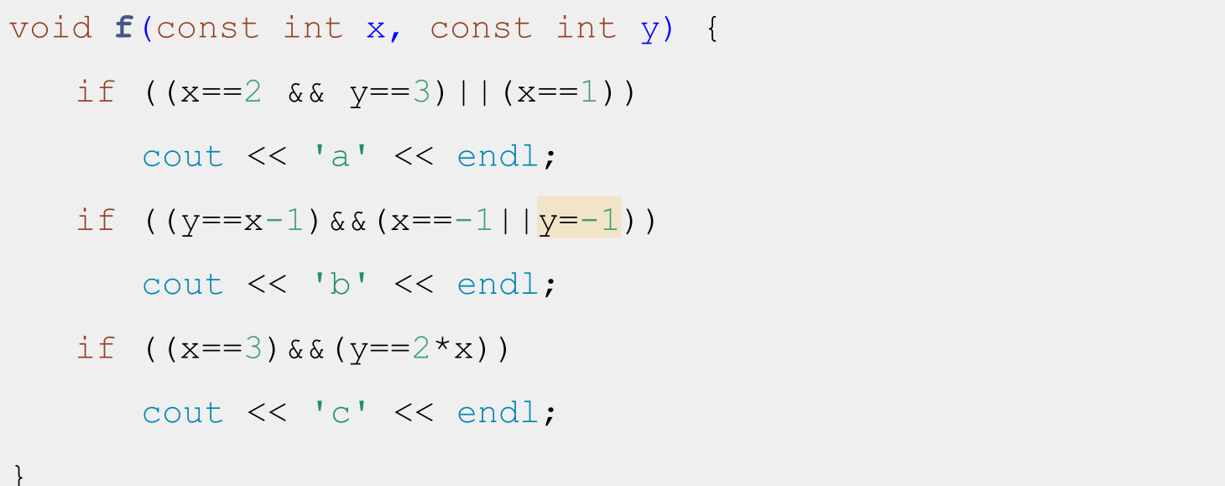
Why const? Find the typo in this code

Slide 32
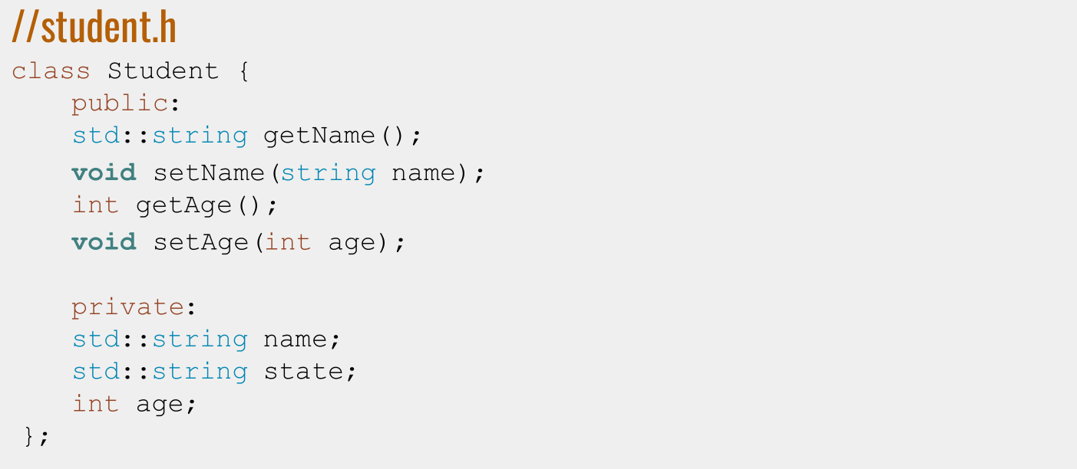
Const and Classes
Recall: Student class

Slide 33
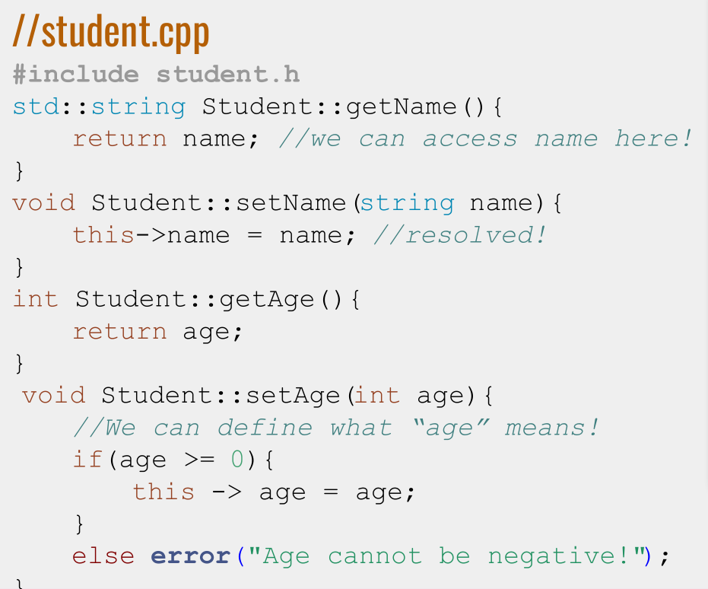
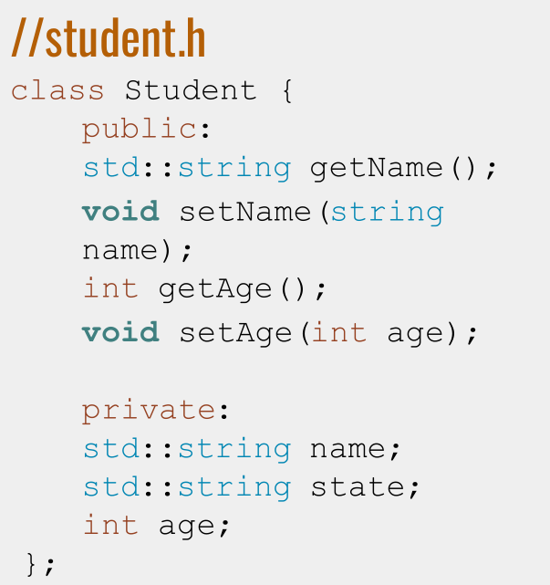

Slide 34
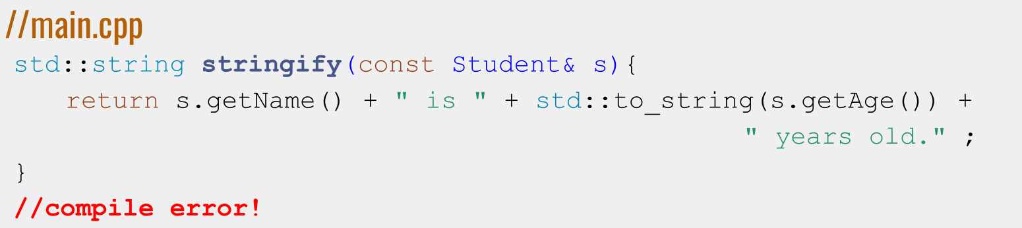
Using a const Student
- The compiler doesn’t know getName and getAge don’t modify s!
- We need to promise that it doesn’t by defining them as const functions
- Add const to the end of function signatures!

Slide 35
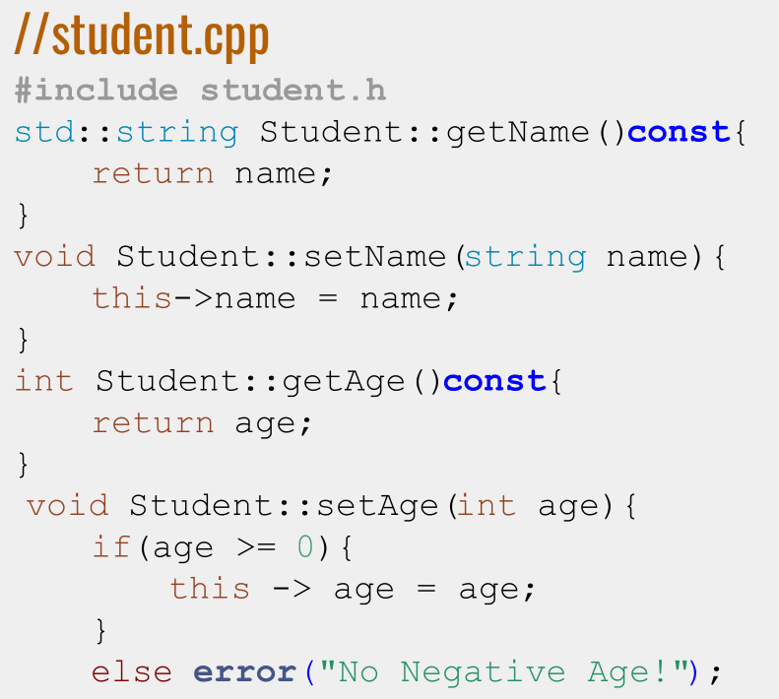
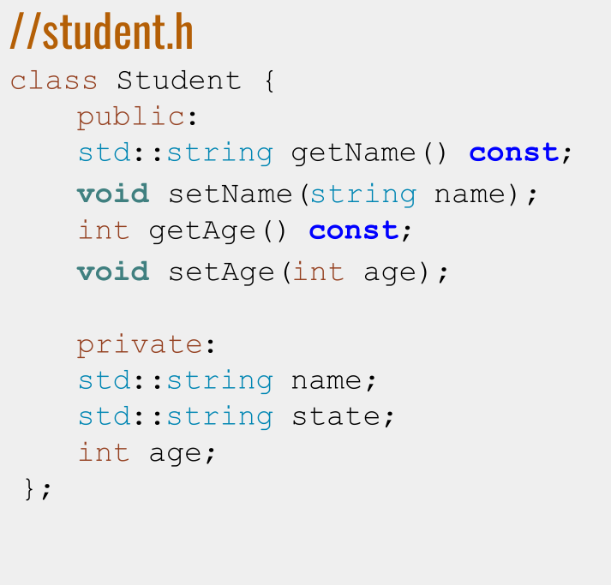
Making Student const-correct

Slide 36
Definition
const-interface: All member functions marked const in a class definition. Objects of type const ClassName may only use the const-interface.

Slide 37
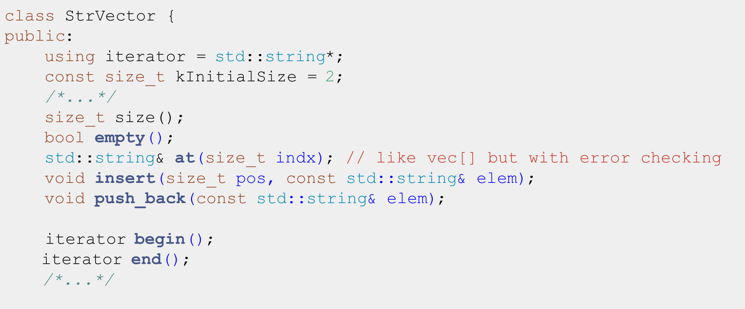
Making StrVector‘s const-interface

Slide 38
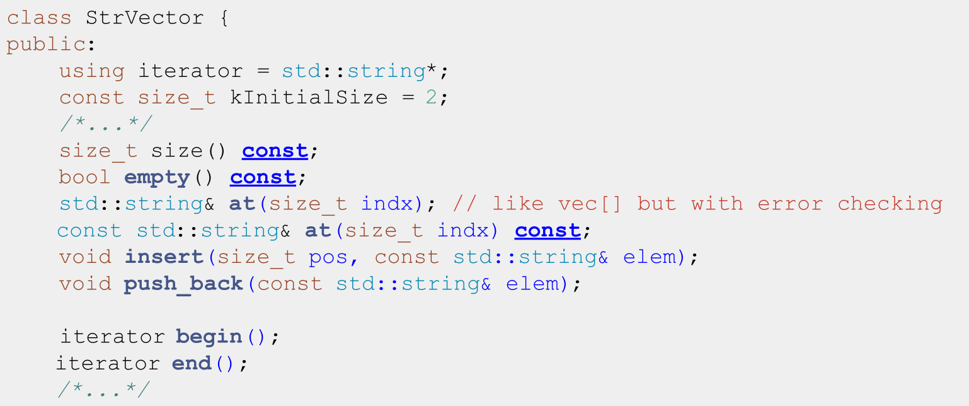
Making StrVector‘s const-interface

Slide 39
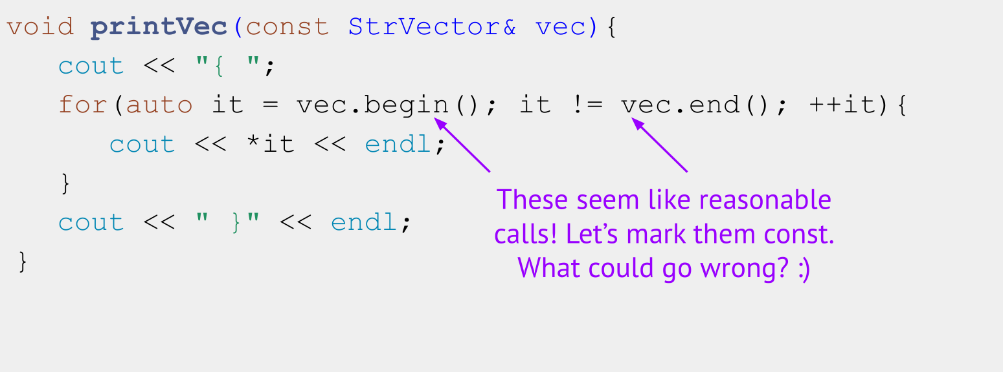
Should begin() and end() be const?
Consider a function with a const StrVector param...

Slide 40
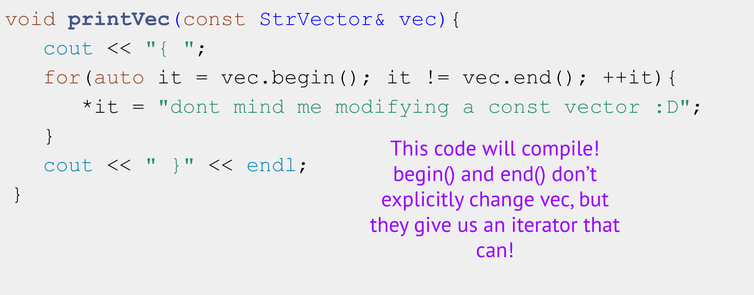
Consider a function with a const StrVector param...

Slide 41
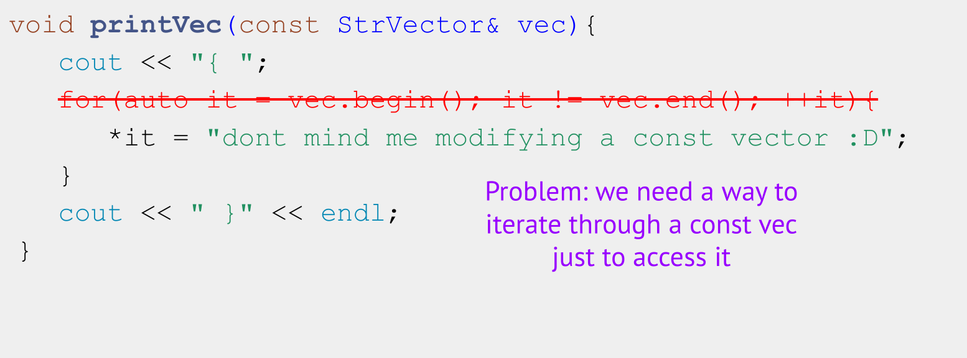
Consider a function with a const StrVector param...

Slide 42
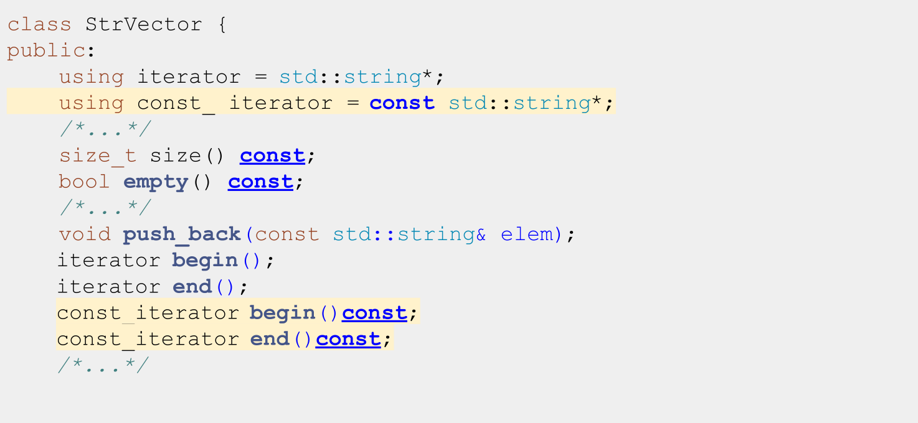
Solution: cbegin() and cend()

Slide 43
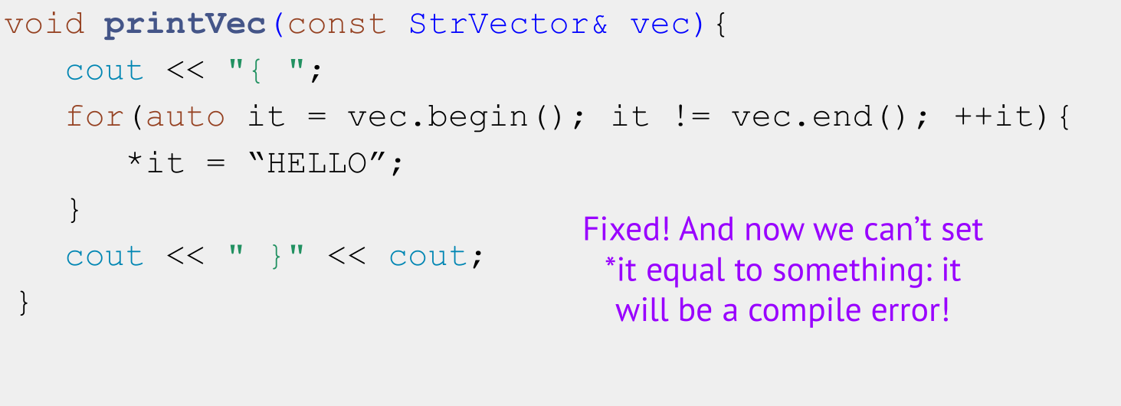
Consider a function with a const StrVector param...

Slide 44
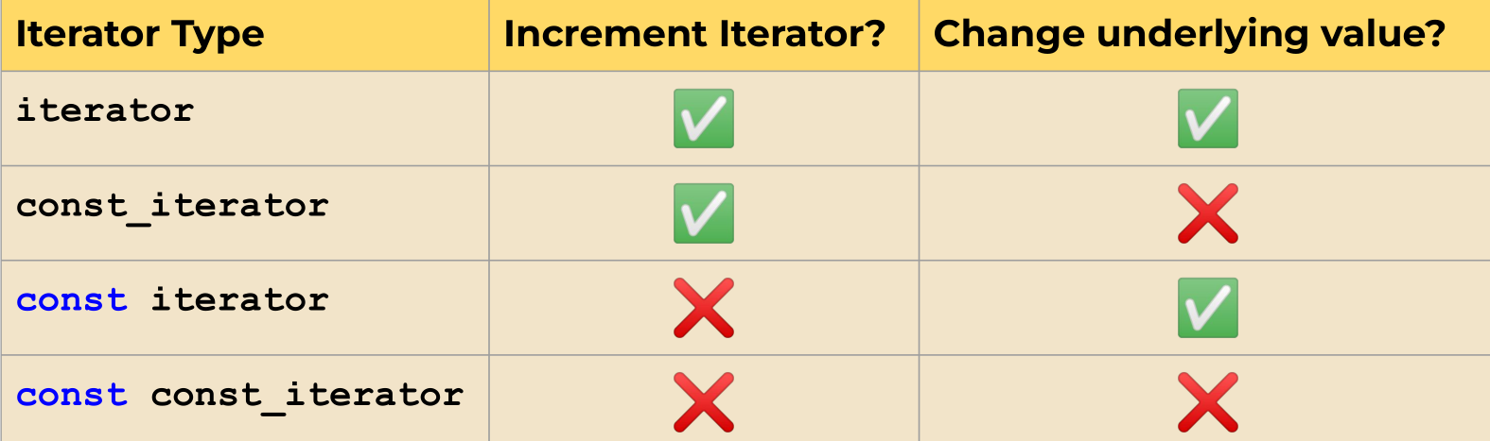
Abilities of Iterator Permutations

Slide 45
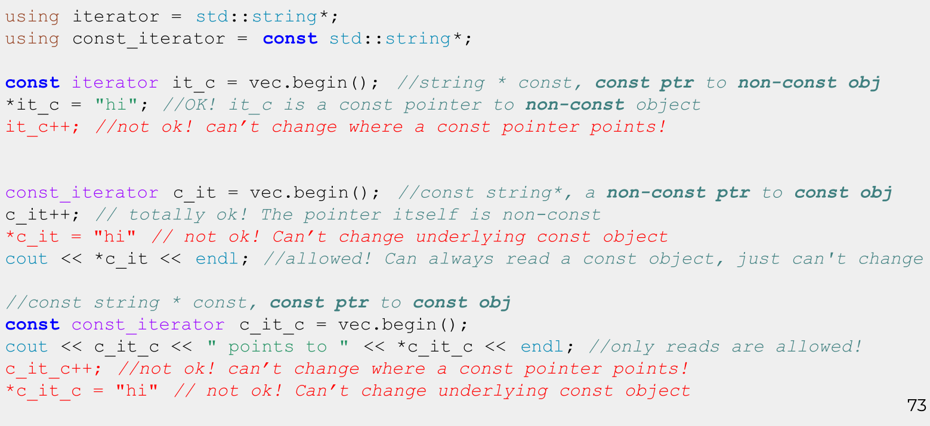
const iterator vs const_iterator: Nitty Gritty

Slide 46
Recap: Const and Const-correctness
- Use const parameters and variables wherever you can in application code
- Every member function of a class that doesn’t change its member
variables should be marked const
- auto will drop all const and &, so be sure to specify
- Make iterators and const_iterators for all your classes!
- const iterator = cannot increment the iterator, can dereference and
change underlying value
- const_iterator = can increment the iterator, cannot dereference and
change underlying value
- const const_iterator = cannot increment iterator, cannot change
underlying value

Slide 47
Recap: Template classes
- Add template<class T1, T2..> before class definition in .h
- Add template<class T1, T2..>before all function signatures in .cpp
- When returning nested types (like iterator types), put typename ClassName<T1, T2..>::member_type as return type, not just member_type
- Templates don’t emit code until instantiated, so #include the .cpp file in the .h file, not the other way around!

Slide 48
Coding for love, Coding for the world
Qijun Zhao
qjzhao@scu.edu.cn

